Slide 1
Subject : CEP product fail ECF002 in Neptune Enterprise (PID:6800)
Prep. By : TE PRB
DD/MM/YY : 24/04/14

Slide 2
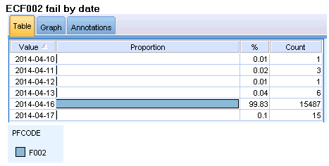
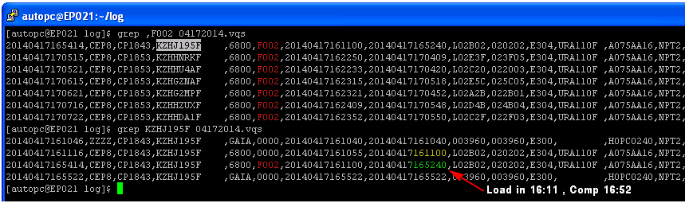
CEP product fail ECF002 in Neptune Enterprise
Background :
On 17 Apr’14 MFG test found CEP product fail error F002 shoot up after resume at SRST/Final test in Neptune automation tester.Total 15,xxx drives from drives running 34k approximately .
Problem Details :
The ECF002 appear after resume plan shut down (EC9998 >>> then ECF002) The status drive was move out from tester 3k (1.5k sending to R/A, 1.5k hold) and remain 12k are hold in the tester for waiting disposition
After sample resume x200 drive fail ECF002,found drive re-create same error. So, the disposition drive can not resume. Need to re-function test with all drive
Resume plan shut down
16 Apr 2014
Can not resume

Slide 3
Problem Title
Investigation/Findings:
We have summary possible root cause below,
Cause :
We suspect current code can not support resume operation.
It is side effect from change item of new code CEP1.36
CEP1.36 BIPed on 4 Apr’14 and have change item below
PPQ raw values (ec6ATF mitigation)
Apply algorithm for CST refinement from CEP1.2F using pack read ML7 (Test time)
TCCR 1649 EC:6TAH refinement (couples with FET) (Yield +0.3%)
We suspect change item 1) due to this change item allocate new memory area.
New memory area make invalid resume pointer.
Invalid resume pointer can not resume at last SRST sequence.
Y=f(x) | Detail | Relate
x1 | Tester problem | No
x2 | Code package problem | No
x3 | Resume functional problem | Yes

Slide 4
Resume Functionality : Problem Analysis
Y = f(x) ; (x1,…,x10)
Y = f(x) | Items | Status
X1 | Revert main sequence. | Apr28:Still Fail F002.
X2 | Remain x1 If() syntax in main sequence | Apr28:Still Fail F002.
X3 | Revert “If” inside “if condition” in main sequence | Apr28:Still Fail F002.
X4 | Remove added xml (x1) | Apr29: Can be resume
X5 | Move new xml from bottom to middle | Apr29:Still Fail F002
X6 | Disable record DRP event log | CP: Apr 30
X7 | CEP1.35 remove unused file (cpp files) | CP: Apr 30
X8 | Remove all added XML file | CP: Apr 30
X9 | Revert all record ML7 in Logical Application | CP: Apr 30
X10 | Reduce main sequence size | CP: Apr 30

Slide 5
Action Summary
Corrective Action :
Fix memory corrupt (CEP1.38)
- Release fix code and bench confirm CP:Apr29’14
- Small lot trial w/ 480 drives CP:May02’14
- Decide FBIP CP:May02’14
- Test code design review
- Resume functionality review
Preventive Action :
TBD CP:May/M’14

Slide 6
Back up

Slide 7
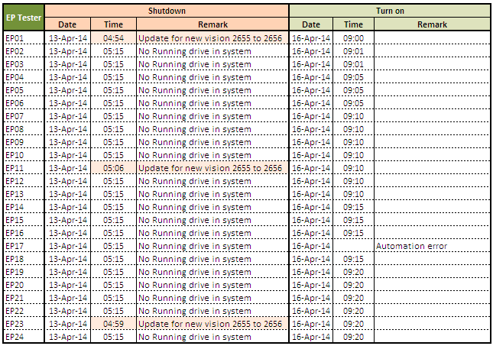
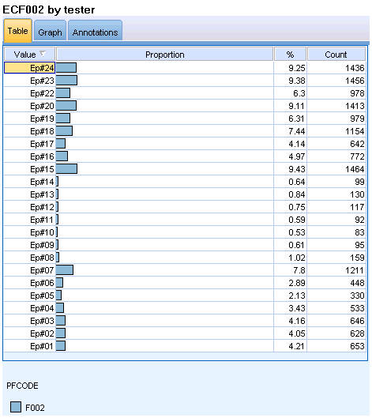

Data Analysis = X1 tester problem
BEFORE | AFTER
Details : MTC completed to resume Neptune Enterprise at 9.00AM 16 April 2014 drive fail EC9998 | Detail : - All drive EC9998 was resume then found F002 fail ECF002 after drive ran 3 hrs approximately. - The ECF002 fail with all tester Neptune II enterprise tester
Drive fail after running 1-3 hrs
Conclusion
x1 : Note relate with tester problem

Slide 8
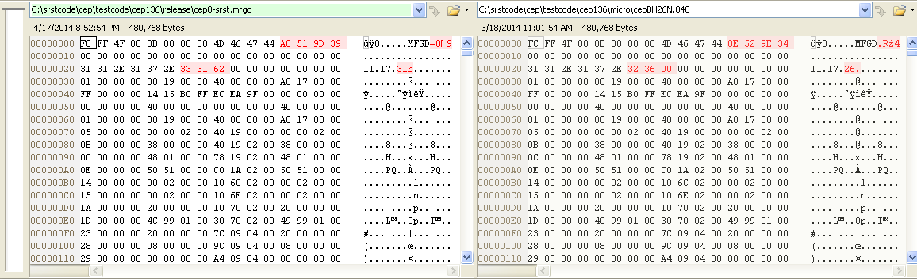
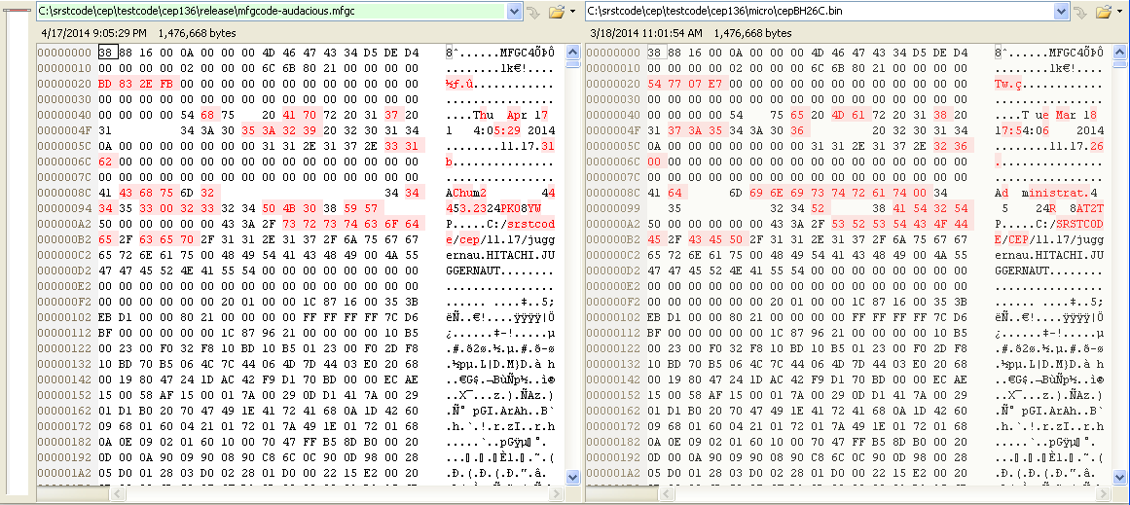
Data Analysis = X2 Code package problem
MFGD Files.
Conclusion
x2 : Note relate with code package
100% same. OK
MFGC Files.
Code section
100% same. OK

Slide 9
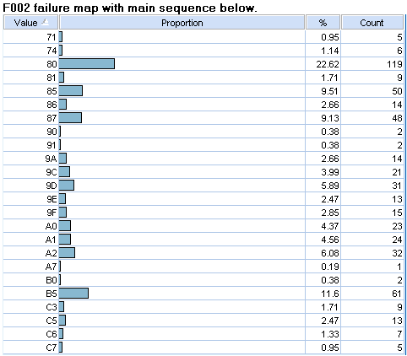
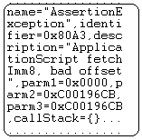
Data Analysis = X3 Resume functional problem
Start
Suspect problem from P plus Q sequence.
RWDC.
Transfer function Analysis.
RRO/NRRO/RTV.
Resume before PPQ OK
Head Instability (SER)
ATI.
P plus Q (61xx)
Pointer to sequence .
Data SAT and SID SAT
Pad SID.
Resume after PPQ fail F002
Functional SAT (logical).
Pad SAT
All sequence after PPQ(61xx) will resume fail F002.
Load Unload.
CSO.
Head Instability (BEM)
CST.
Pad and fill.
Final Pack Scan.
Final Pack Scan Revisit.
End

Slide 10
Action Summary
Containment Action :
Hold drive fail F002 total effect 15,xxx drives and then alert team to investigate Done. 17Apr’14
Trial resume x200 drive fail F002 for resume confirmation Done. 17Apr’14
Assign disposition all CEP fail F002 to re-function test .
Recovery 15K Done: 19 Apr 14
Recovery by allocate tester from CBE and convert x9 TDI LUXON Done. 18 Apr’14
SRST test input
Recovery 13.5K Done. 25 Apr’14
Recovery by allocate / utilze emtry slot tester from CBE and Sunday OT Done. 25 Apr’14
Actual output SRST are 40,115 unit. As recovery plan confirm on Apr 25 at 8:00 AM

Slide 11
Action Summary.
Preventive Action :
Fail suddenly when Program Counter memory corrupt. (CEP1.39) Plan trial May begin.
Pcode Address.
Start
Should be.
Problem.
0
RWDC.
PC = 1.
PC = 1.
1
Transfer function Analysis.
2
PC = 2.
PC = 2.
3
RRO/NRRO/RTV.
.
Head Instability (SER)
.
PC = 3.
PC = 3.
.
ATI.
P plus Q (61xx)
PC = 4.
PC = 4.
Data SAT and SID SAT
Memory Corrupt.
Pad SID.
PC = 5.
PC = 2000.
Functional SAT (logical).
Pad SAT
(1200 – 4) = 1196 which > 1 Fail 6ASX.
Load Unload.
(5 – 4) = 1 which > 1 will run normally.
CSO.
PC = Program Counter.
(Memory use for resume)
Head Instability (BEM)
Condition for checking every step
, so this problem will fail at trial step.
.
CST.
.
Pad and fill.
If
(New PC – Previous PC) >1
Then
Fail 6ASX suddenly.
.
Final Pack Scan.
1000
Final Pack Scan Revisit.
End

Slide 12
Back Up

Slide 13
Activity to find root cause.
 | TE activity to fix F002. | Remark.
1 | Short Sequence then abort on Niagara bench. -Do short PPQ follow by SAT ➔Pass normally. | Apr 19: The drive can resume as normally
2 | F002 relate with Servo code (V1, V2.5) ➔Not Relate. | Apr 21:Done: not relate(V2.5 load only 3k)
3 | Short Sequence then abort on Neptune bench. -Do short PPQ follow by SAT ➔Pass normally. | Apr 22 The drive can resume as normally
4 | Full sequence. -PPQ and Binning(2units.) ➔Fail F002 -PPQ only(2units.)➔ Pass normally -Binning only(2units.) ➔ Fail F002 | Apr22: Start running and on going. Apr24: Abort (During Data SAT) then resume normally. Apr25: After PPQ Fail#F002.
5 | Full sequence. Abort at 10/30/52/70 hrs. (Re-Create x90 unit.) | Apr22 : Start running and on going. - Step 0: Control load CEP x90 unit to CPC114>> Comp - Step 1: (10hrs)Shutdown CPC+SIO, then resume >> Comp (23'Apr 05:00) - Step 2: (30hrs)Shutdown CPC+SIO, then resume >> Comp (24'Apr 01:00) - Step 3: (52hrs)Shutdown CPC+SIO, then resume >> x58FailF002 ( \25'Apr 23:00)
6 | Narrow the root cause. 1 Revert main sequence.➔ Apr28:Still Fail F002. 2 remain x1 If() syntax in main sequence.➔ Apr28:Still Fail F002. 3 revert If inside if condition in main sequence.➔ Apr28:Still Fail F002. 4 Remove xml of binning criteria.➔ CP: Apr 29 5 Move new xml from button to middle.➔ CP: Apr 29 6 Don’t record DRP evenly log. ➔ CP: Apr 29 7 CEP1.35 remove unused file.➔ CP: Apr 30 8 Remove all added XML file.➔ CP: Apr 30 9 Revert all record ML7 in Logical Application.➔ CP: Apr 30 10 Reduce main sequence size ➔ CP: Apr 30

Slide 14
Change item concern.
Test code Change Item. | Relate. | Reason.
Revert IP code.(CEP1.37) | Not concern.
Revert 6ATI (CEP1.37) | Not concern.
Binning concept(cep1.36) | Risk. | Add many file.
6TAH refinement.(cep1.36) | Not concern. | Just change number and condition.
PPQ (raw to sin address.)(CEP1.36) | Risk. | The change relate with data address.
New mfgid (CE2xxx)(CEP1.35) | Not concern.
6ETF.(CEP1.35) | Not concern.
6ATI refinement.(CEP1.35) | Not concern.
6TFM refinement.(CEP1.35) | Not concern.

Slide 15
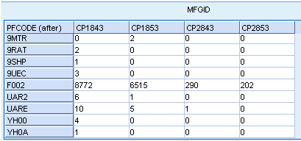
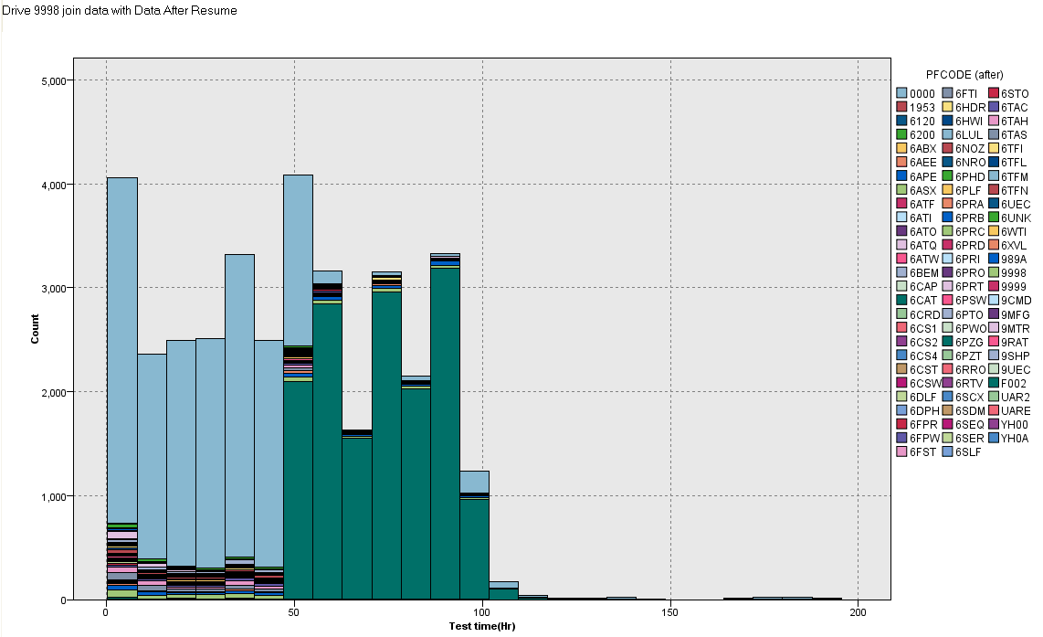
Back up symptom of F002
Fail all MFGID.
All drive fail After 51 hrs.
Fail from Progress 71(SAT Test).

Slide 16
Improvement Topic
Action :
BIP date :
Current | New
Picture
Picture
Text
Text

Slide 17
End of Report

